Slide 1
HAEMOLYTIC ANEMIA
DR.PRAHALAD SHARMA
MD

Slide 12
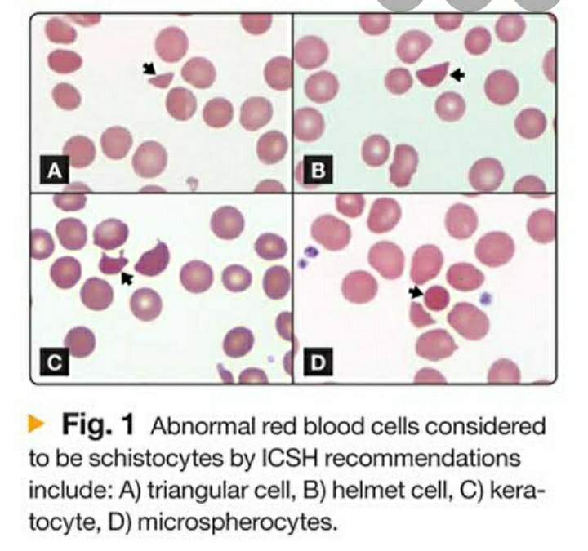

Slide 13
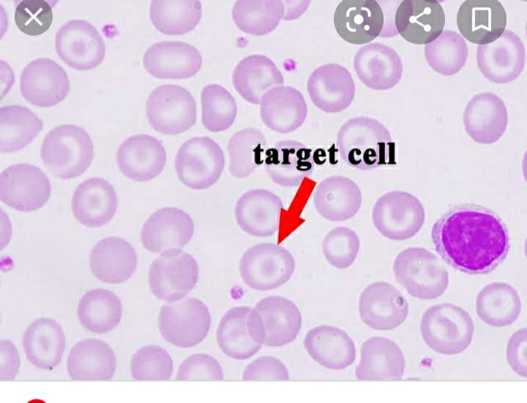

Slide 14
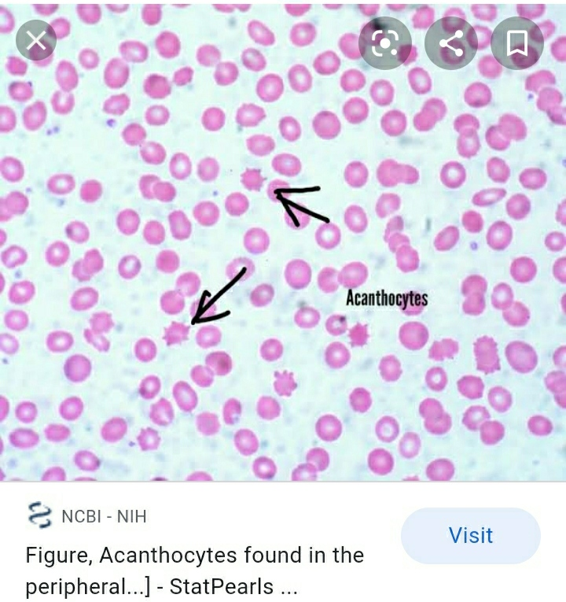

Slide 15
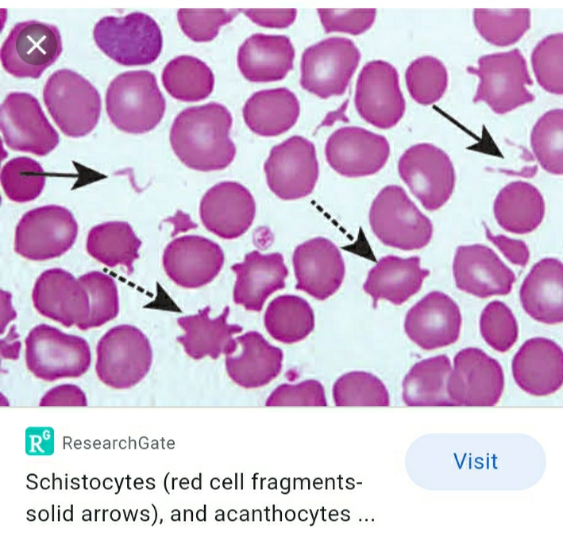

Slide 16
